Slide 1
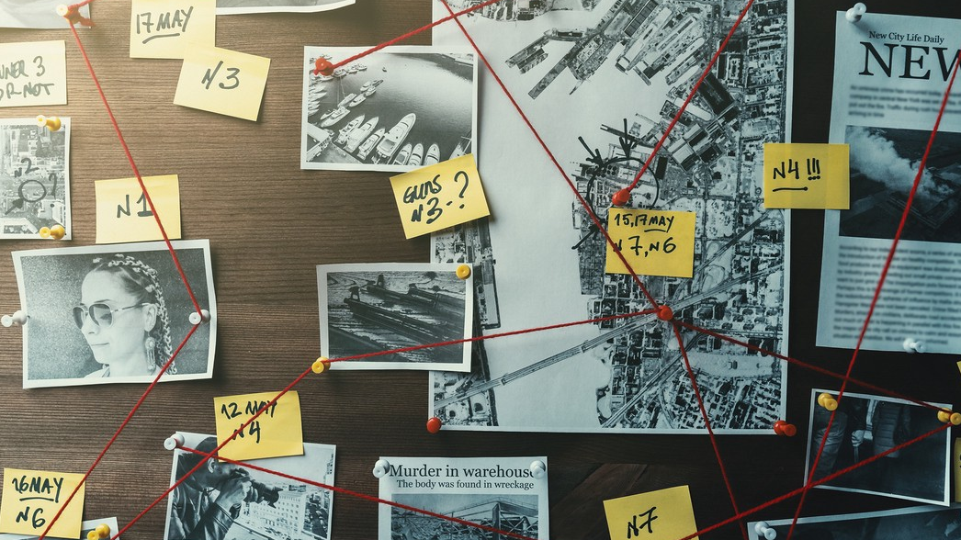
Crimes in Boston: Data Analysis using R
Prepared By:
Mir Rafiul Ahmed ( 2017231005)
Md. Soumit Farhan (2017231024)
Toumik Akter Snaha (2017231037)
Esrat Jahan Eva (2017231039)
Khadija Akter (2017231045)
Md. Atahar Shehab (2017231052)
Prosenjit Deb (2017231058)
Mahin Iqbal Chowdhury (2017231068)
Md. Imam Hossain ((2016231038)

Slide 2
About Dataset
Context
We have chosen the dataset ‘Crimes in Boston’ which is basically crime incident reports, provided by Boston Police Department (BPD) to document the initial details surrounding an incident to which BPD officers respond. This is a dataset containing records from the new crime incident report system, which includes a reduced set of fields focused on capturing the type of incident as well as when and where it occurred.
Content
Records begin in June 14, 2015 and continue to September 3, 2018. This dataset contains 327821 records over 2015-2018 timeframe
Acknowledgements
The data is a public source provided by Analyze Boston. The most up-to-date version can be found here

Slide 3
Types of Data Mining/ Econometric Techniques used in Project
Descriptive Statistics (Explanatory Data Analysis)
Regression (Single and Multivariate Regression)
Hypothesis (F test)
Forecasting (ARIMA)
Heteroscedasticity (Breusch-Pagan Test and White Test)
Multicollinearity (Variance Inflation Factor)

Slide 4
Theoretical Area for Topic
This data analysis would fit in the macroeconomic area as this dataset is concerned with crime records of Boston from 2015-18 with more than 0.3 million records.

Slide 5
Package Used in this Project
install.packages("ggplot2") – General Scheme for Data Visualization
install.packages("stargazer") – For creating quality tables and summary statistics
install.packages("aggr") – For calculating or plot the amount of missing/imputed values in each variable and the amount of missing/imputed values in certain combinations of variable
install.packages("dplyr") - a package for making data manipulation easier
install.packages("tidyverse") - an opinionated collection of R packages designed for data science. All packages share an underlying design philosophy, grammar, and data structures.
install.packages("janitor") - expedite the initial data exploration and cleaning that comes with any new data
install.packages("forecast") - provides methods and tools for displaying and analysing univariate time series forecasts including exponential smoothing via state space models and automatic ARIMA modelling
install.packages("magrittr") – provides a mechanism for chaining commands with a new forward pipe operator %>%
install.packages("wooldridge") – aims to lighten task by efficiently loading any dataset found in the text with a single command
install.packages("skedastic") – make diagnostic methods for detecting heteroscedasticity in linear regression model
install.packages("lmtest") – collection of tests datasets and examples for diagnostic checking in linear regression model

Slide 6
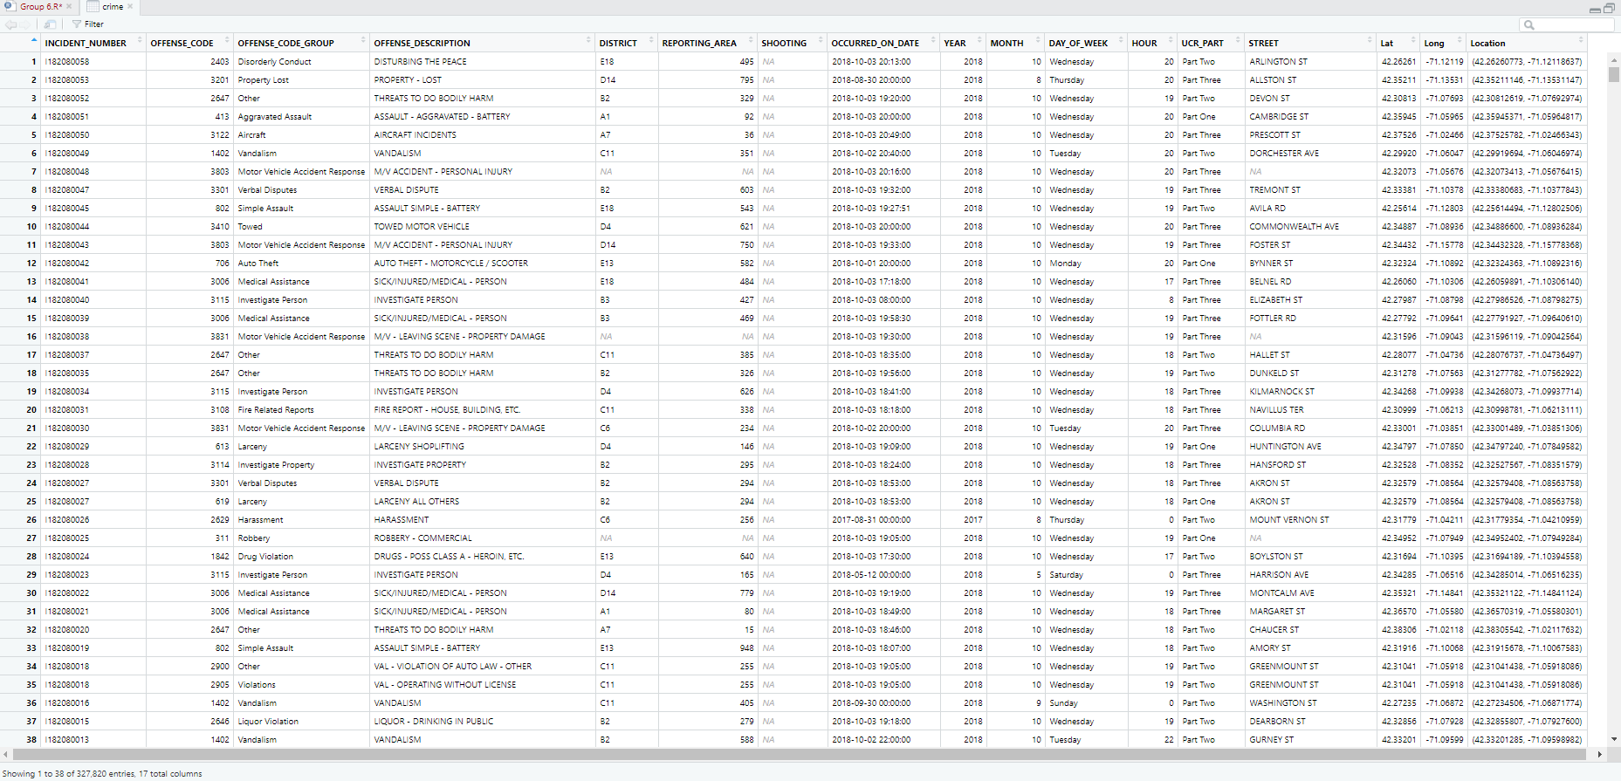
Dataset in a Glimpse

Slide 7
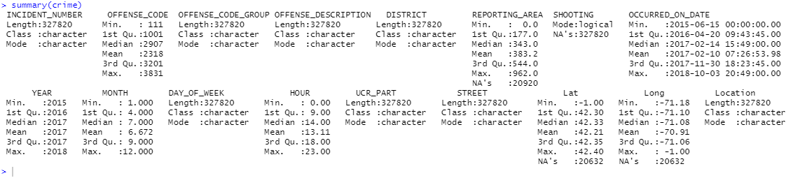
Visualizations
Summary of crime data file

Slide 8
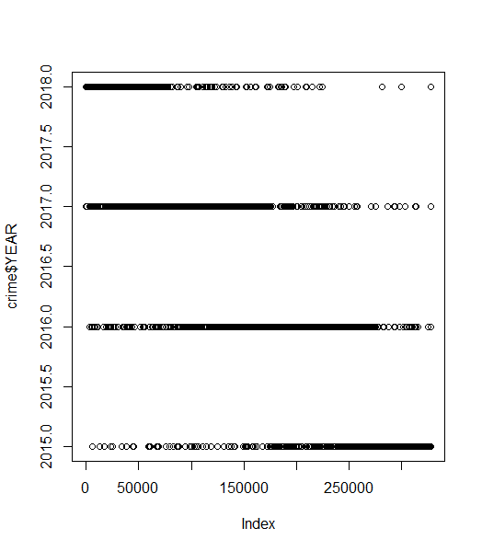
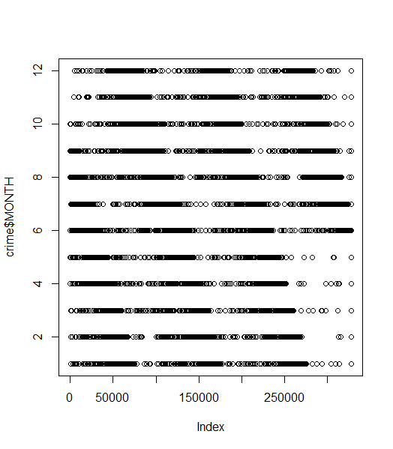
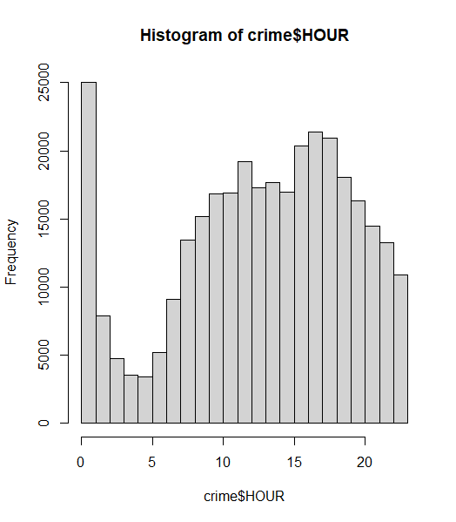
Crime Data Plotting

Slide 9
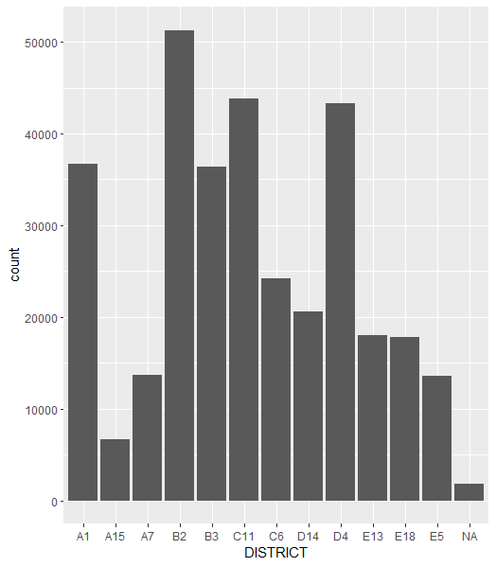
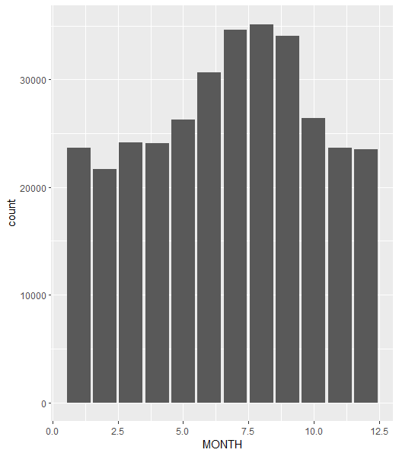
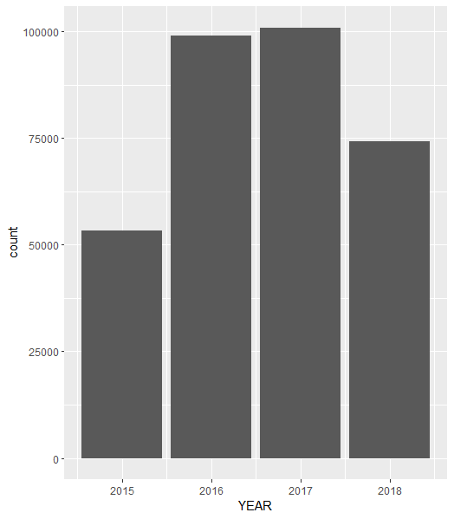
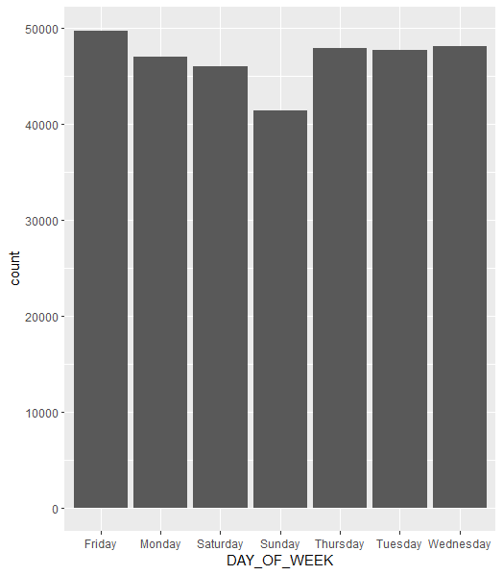
Crime Analysis over District, Month, Year and Day of the Week

Slide 10
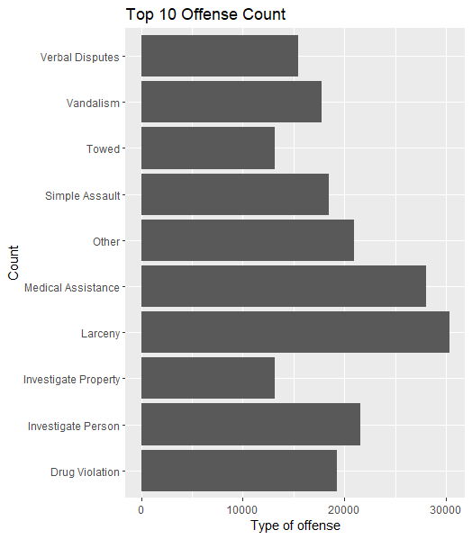
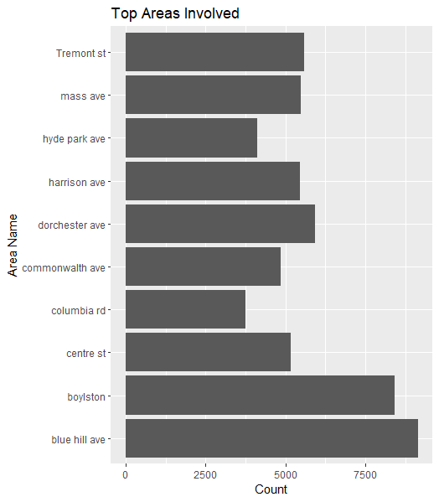
Top Crime and Area Analysis

Slide 11
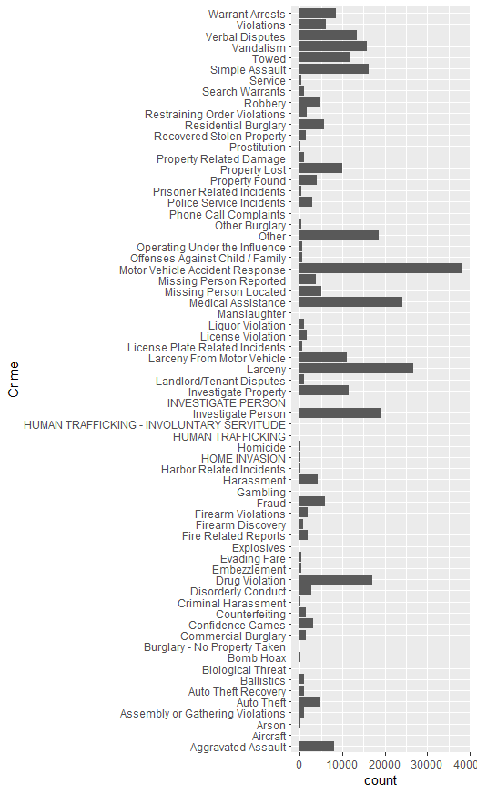
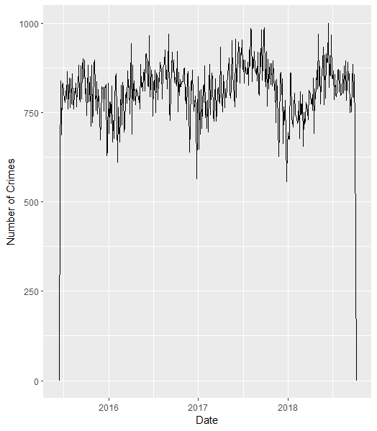
Crime Frequency

Slide 12
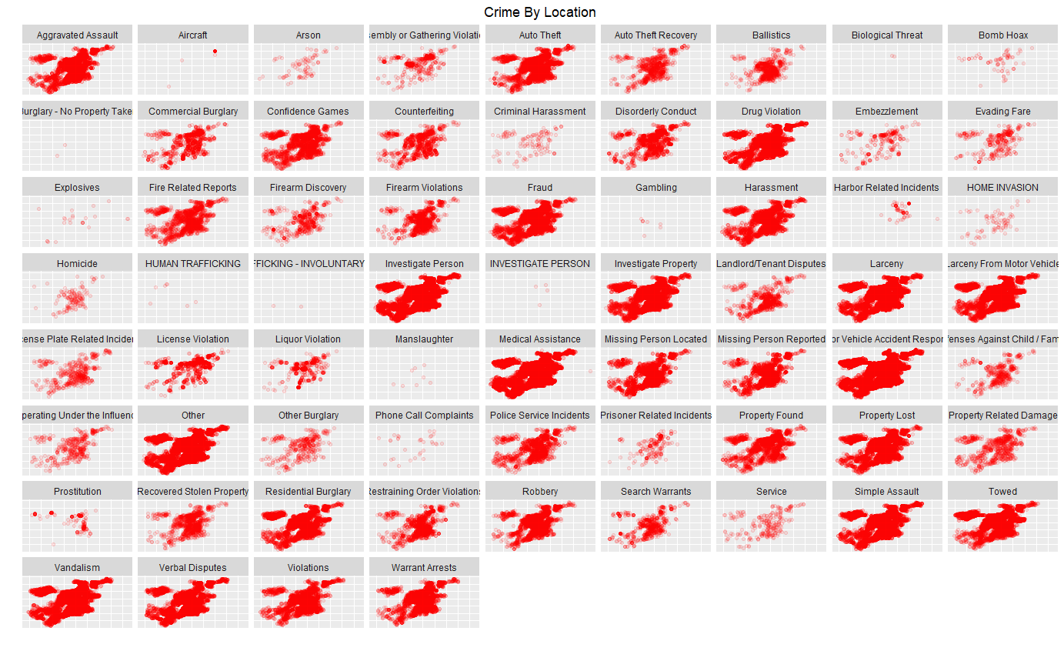
Heatmap of Crime By Location

Slide 13
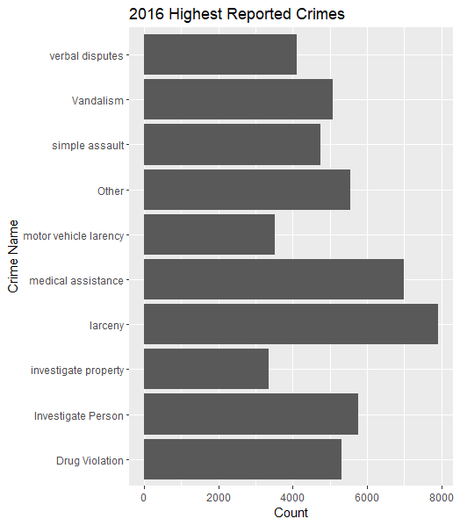
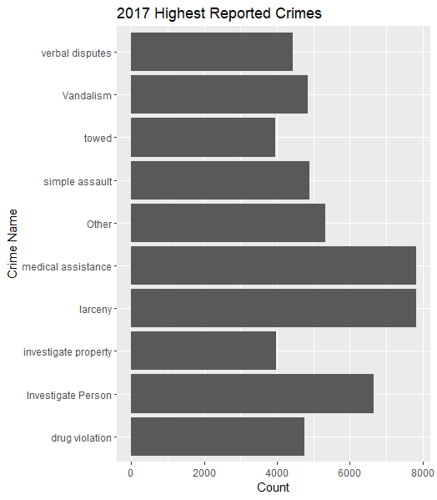
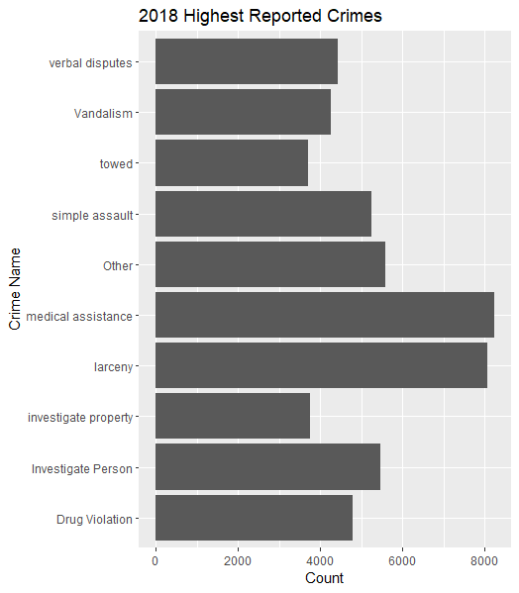
Crime Analysis Over Time Period 2016-18

Slide 14
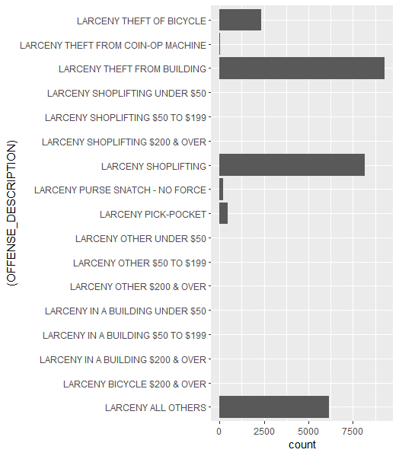
Deep Crime Analysis

Slide 15
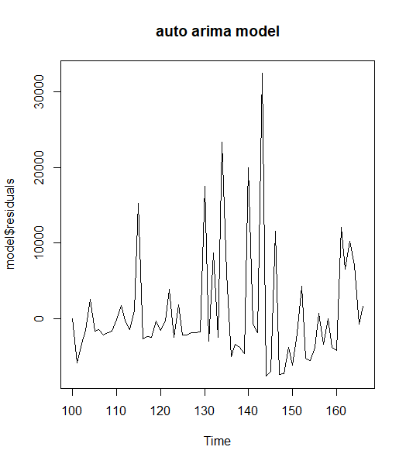
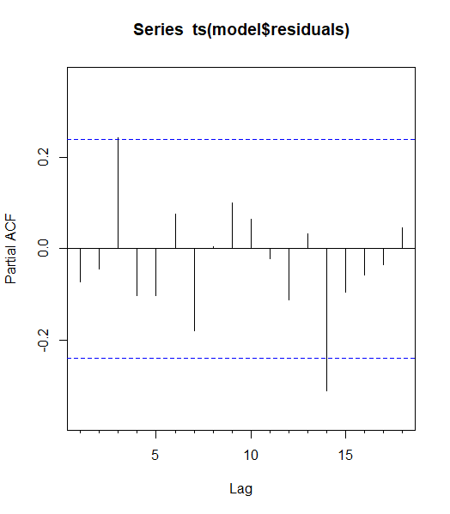
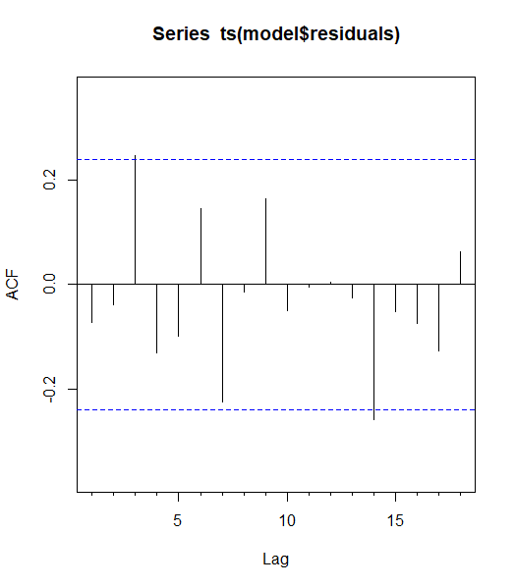
Time Series Forecasting

Slide 16
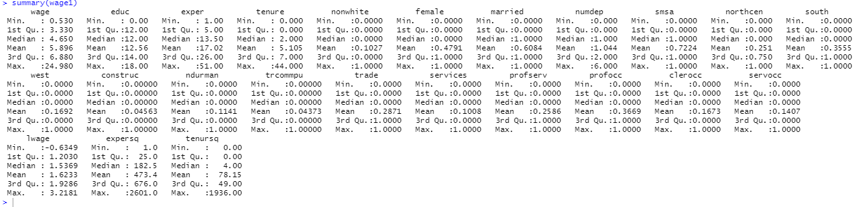
Regression Analysis

Slide 17
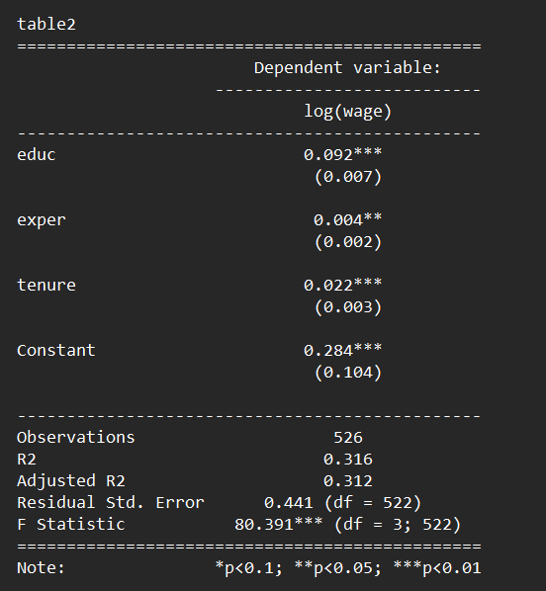
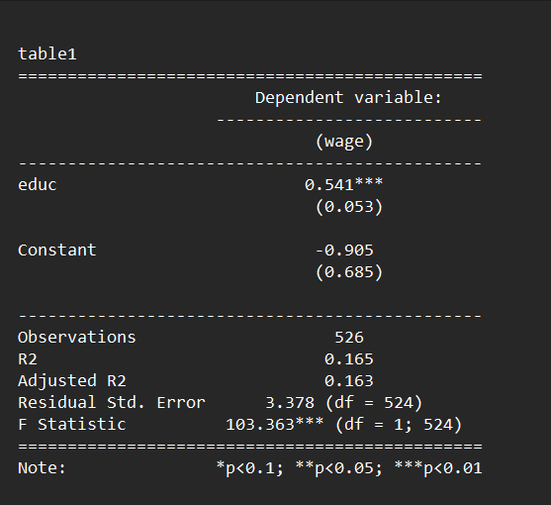
Regression (cont.)
Multivariate Regression
Simple Regression

Slide 18
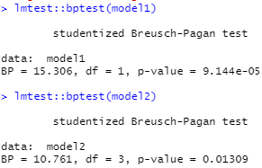
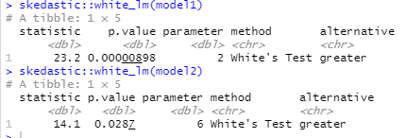
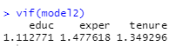
Heteroscedasticity Test (Breusch-Pagan Test and White Test)
Multicollinearity Test (VIF)

Slide 19
Contribution Acknowledgement
Md. Atahar Shehab (2017231052) – Initial Steps, Data Import
Md. Soumit Farhan (2017231024) – Installing Packages, Summary Statistics
Md. Imam Hossain ((2016231038) – Creating Data frame, Recoding, Data Visualization
Khadija Akter (2017231045) – Data Sorting, Specific Data Fetching
Toumik Akter Snaha (2017231037) – Top 10 Crimes, Top Areas Involved, Frequency of Crime
Mir Rafiul Ahmed ( 2017231005) – Area of Crime evolved over time, Deep Crime Analytics and Time Series Forecasting
Prosenjit Deb (2017231058) – Data Frame Creation Part 2
Mahin Iqbal Chowdhury (2017231068) – Simple and Multivariate Regression Analysis, Heteroscedasticity and Homoscedasticity

Slide 20
Thank
You

